Slide 1

Credit card transaction analysis
TEAM MEMBERS:
Rajasekharreddy Kamireddy
Nikhilavaishnavi Katteboina
Krishnateja Garampalli
Sai Ganesh Illapu
Peddabala Anuja

Slide 2



Slide 3
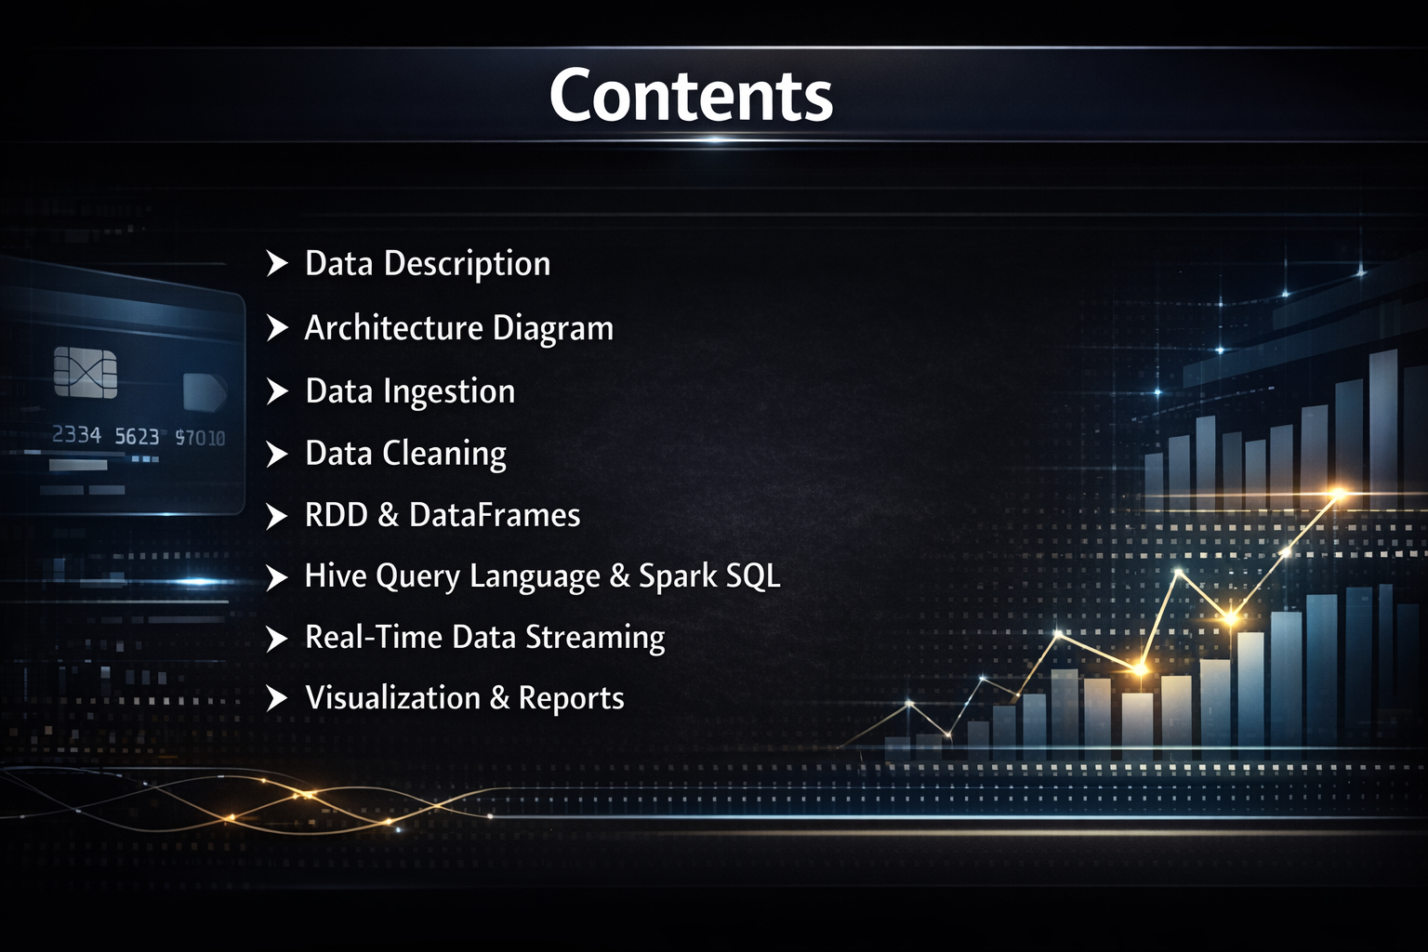


Slide 4

Data Sources
Data Ingestion & Orchestration
Lakehouse Data Lake
Data Processing & Analytics
Visualization & Consumption

Slide 5

Dataset name: Credit Card Transaction Dataset
Data Description
This dataset contains historical records of credit card transactions made by customers.
Each record represents a single transaction, capturing essential details such as the transaction date, card type used, expense category, customer gender, and transaction amount.
The dataset is designed to analyze customer spending behavior, identify transaction patterns, and generate financial insights.
It is suitable for exploratory data analysis, visualization, and business intelligence applications in the banking and financial domain.

Slide 6
Date: Represents the date on which the transaction occurred
Stored in DD-MMM-YY format
Enables:
Time-based analysis
Monthly and yearly trend identification
Seasonal spending insights
Gender: Gender of the cardholder
Values: M – Male, F – Female
Useful for demographic-based spending analysis
Dataset Attributes and uses
CardType: Indicates the type of credit card used
Examples: Gold, Silver, Platinum, Signature
Helps in analyzing spending patterns across different card categories
ExpenseType: Represents the category of spending
Common categories include:Bills, Fuel, Grocery, Entertainment, Travel
Used to understand customer lifestyle and spending priorities
Amount: Monetary value of the transaction
Used for:
Total and average spending analysis
Identifying high-value transactions
Financial trend evaluation

Slide 7


Slide 8


Problem Statement :
Credit card transactions are generated daily across different cities, card types, and expense categories for PK&G Finance Company.
Raw transaction data is large and difficult to analyze directly.
The goal of this project is to process and analyze credit card transaction data to understand spending patterns.
The project focuses on answering business questions such as top spending cities, highest spending months, cumulative spends,
and weekly/Monthly transaction behavior.
Processed data is visualized using Power BI reports to help stakeholders easily understand the insights.
This project helps convert raw data into meaningful information
for better business decisions.

Slide 9
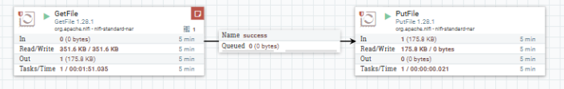
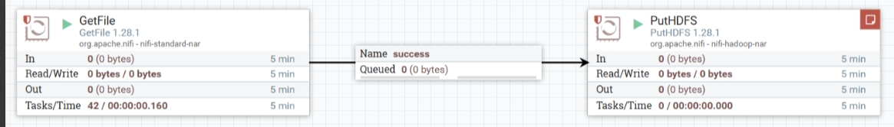
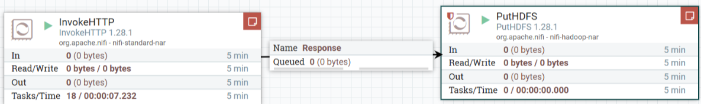
Data Ingestion
NIFI :
Moves files from source folder to target folder
Transfers local files into HDFS.
Pulls data from an API and lands it safely in HDFS

Slide 10
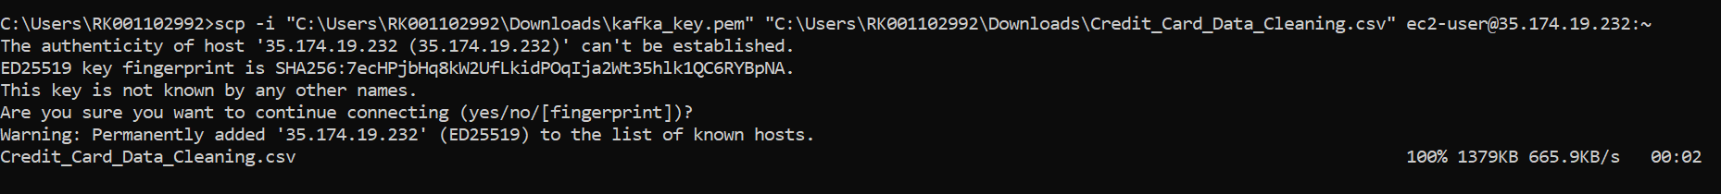
KAFKA :
Kafka Topic Creation (Server Side)
Creating and listing Kafka topics on the Kafka broker using CLI commands.
Kafka Topic Creation (Server Side)​
Creating and listing Kafka topics on the Kafka broker using CLI commands.​
EC2 to Local Data Transfer (Command Prompt)​
Securely copying data from an EC2 instance to the local machine viaterminal.

Slide 11
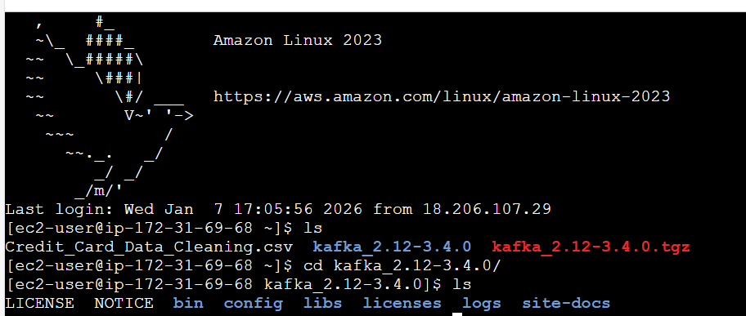
Starting Kafka Server
Launching the Kafka broker service to enable message streaming.
Starting Kafka Producer
Starting Kafka Consumer

Slide 12
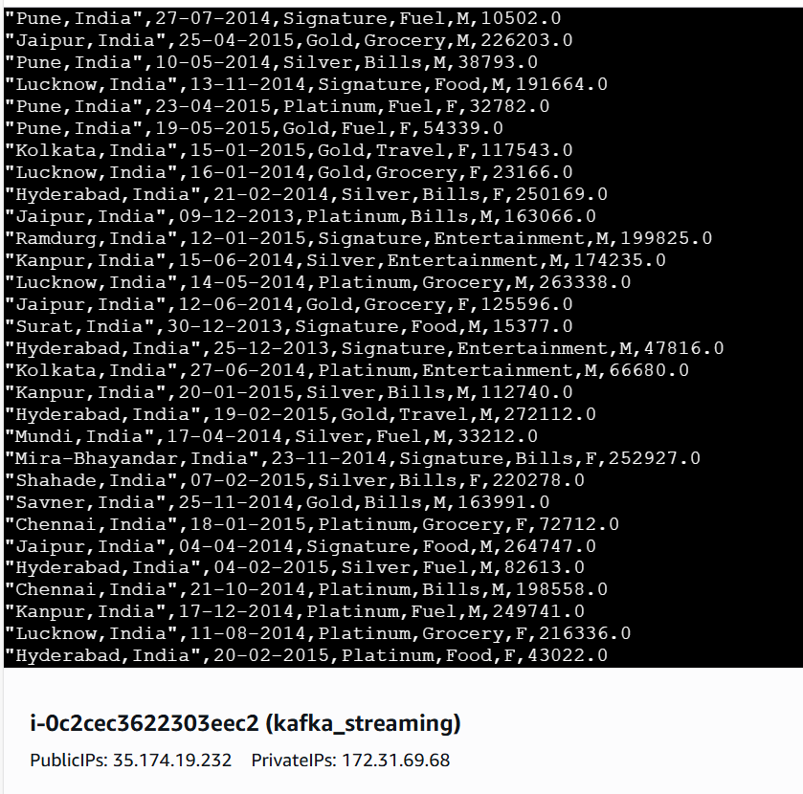
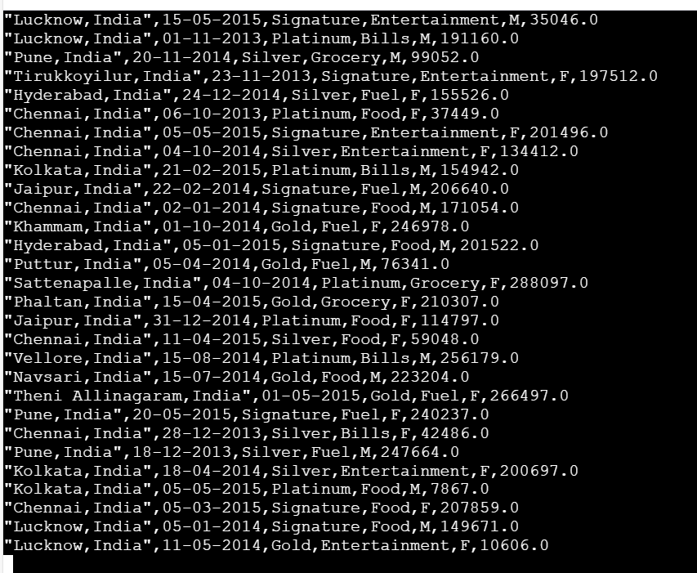
Kafka data ingestion output

Slide 13
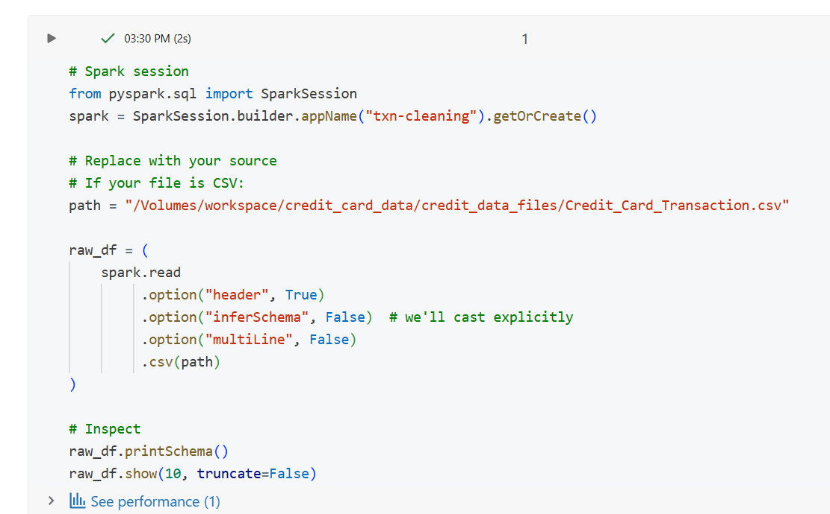
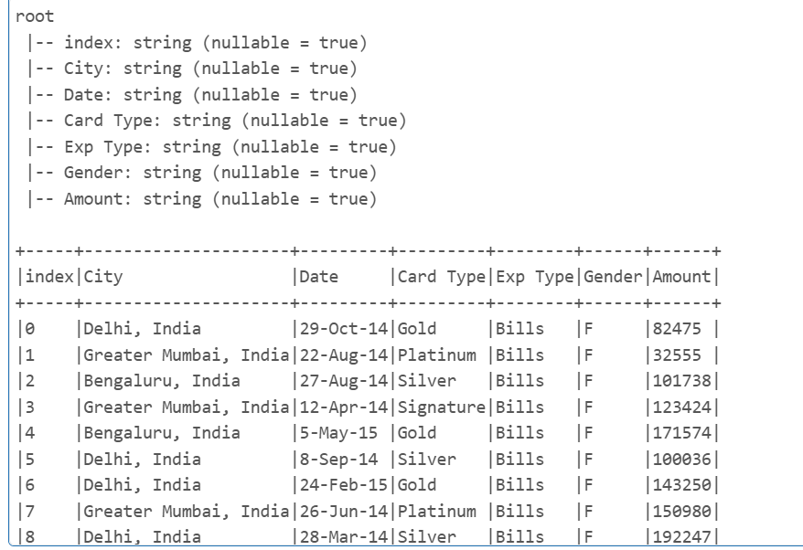
Data cleaning ​
Reads raw CSV data into Spark, inspects the schema, and prepares it for cleaning and transformation.

Slide 14
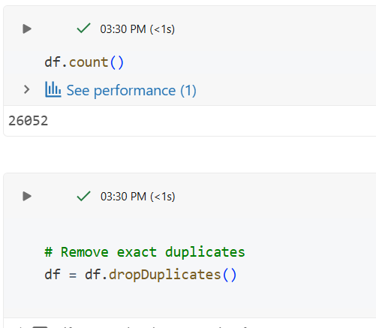
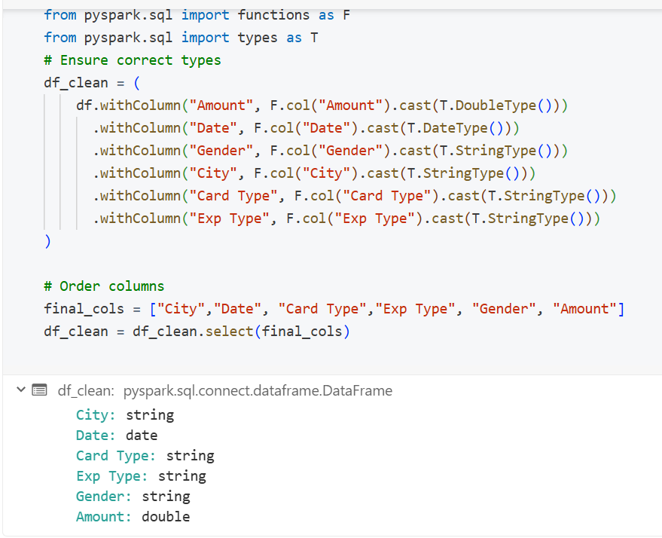
Counts the total records,
And eliminates the duplicate records in the dataset
Converts columns into correct datatypes

Slide 15
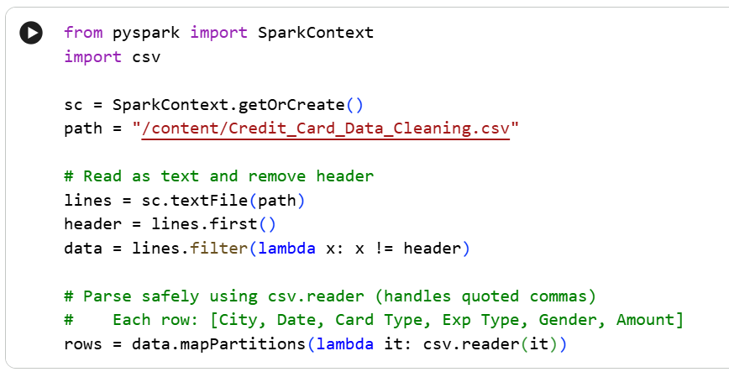
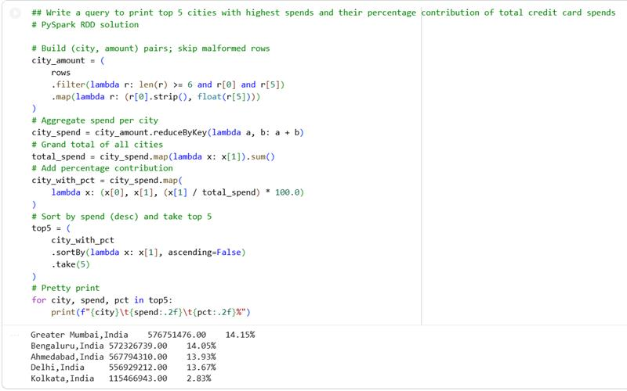
Finds top 5 cities by Spend using RDDs
Reads and Parses CSV data ​
using PySpark RDDs

Slide 16
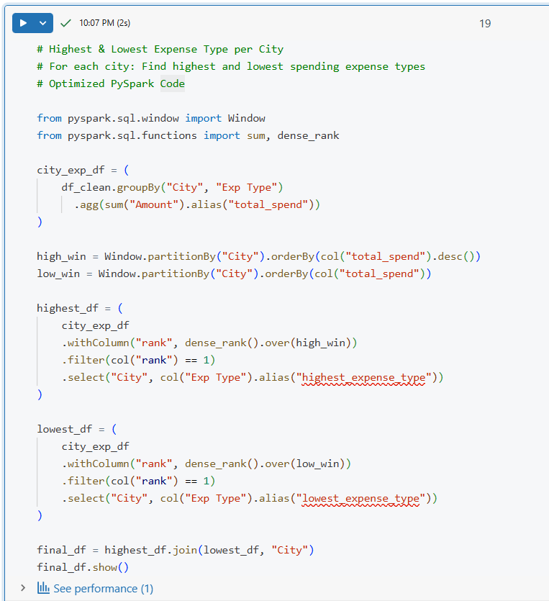
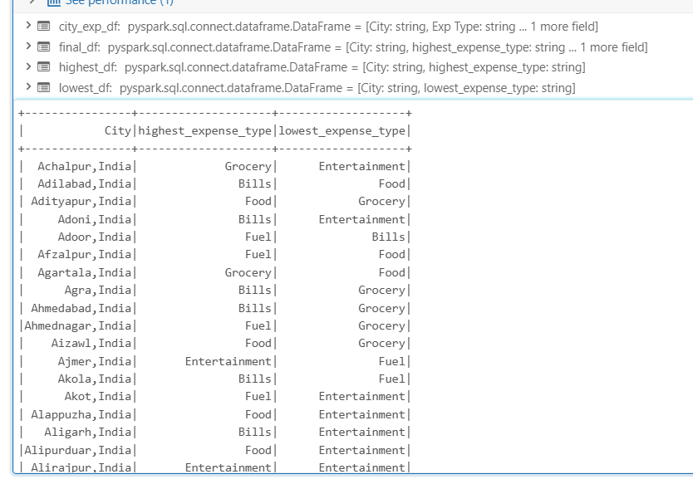
Highest & Lowest Expense Type per City

Slide 17
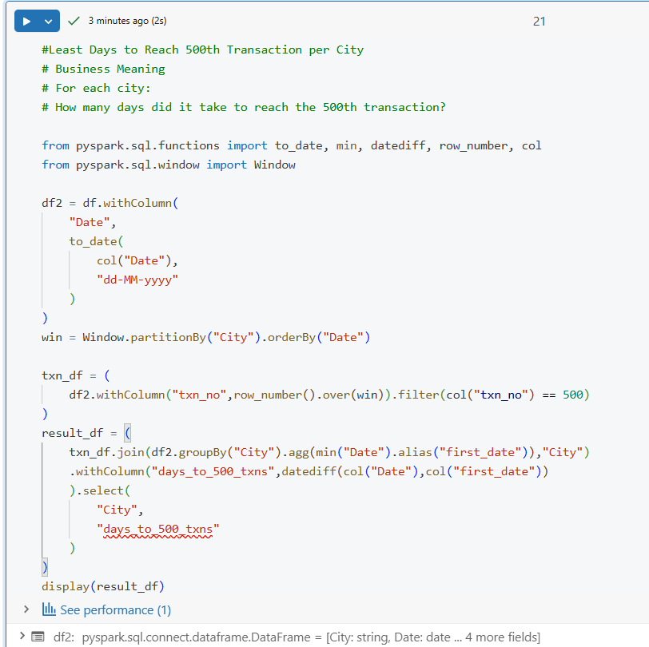
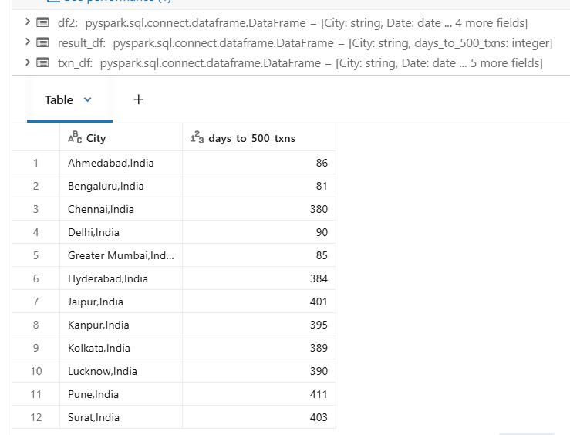
Least Days to Reach 500th Transaction per City

Slide 18
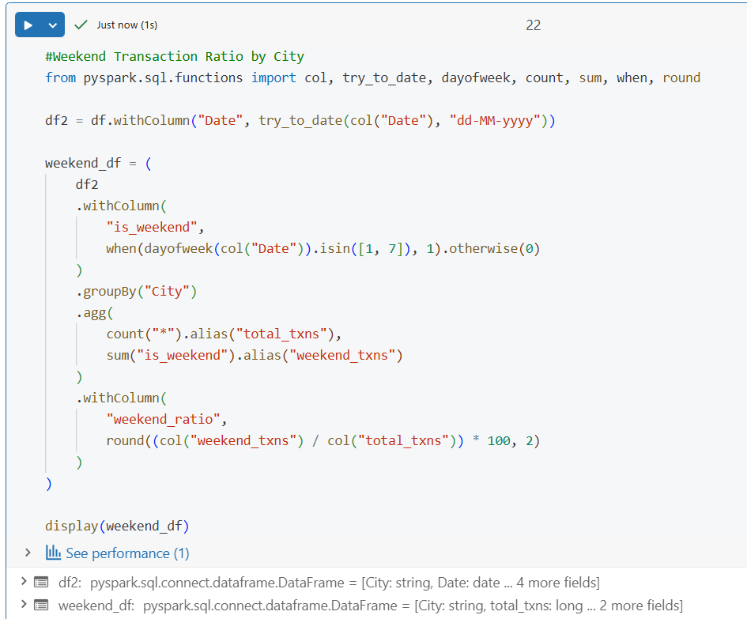
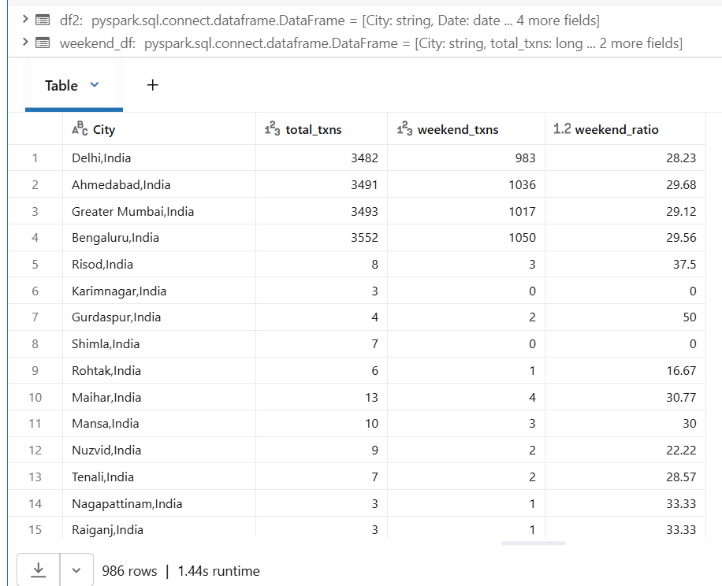
Weekend Transaction Ratio by City​

Slide 19
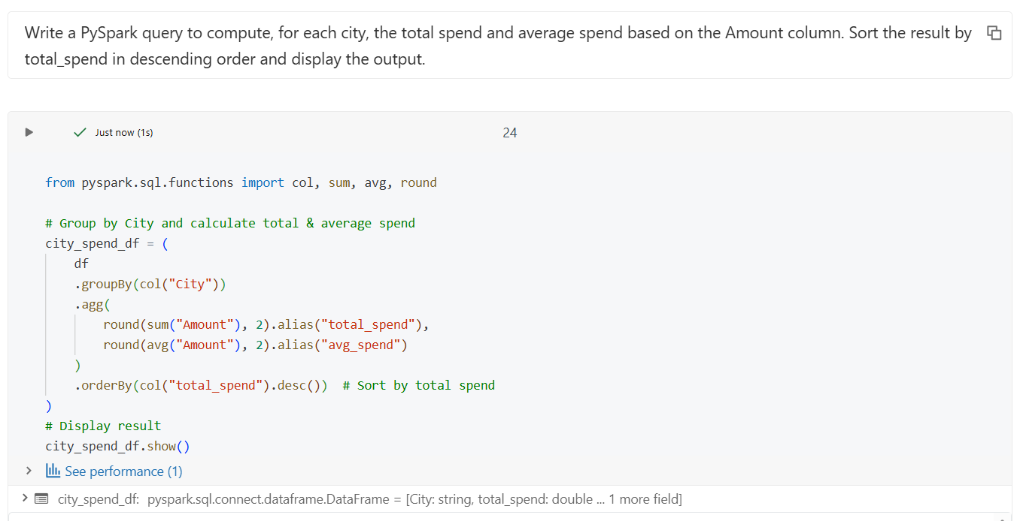
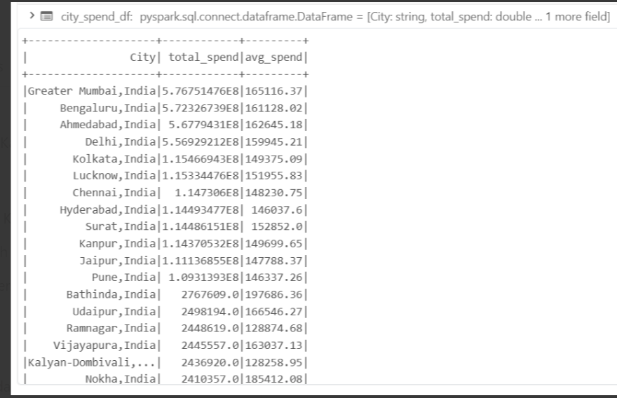
Write a PySpark query to compute, for each city the total spend and average spend based on the Amount column. Sort the result by​ total_spend in descending order and display the output.

Slide 20
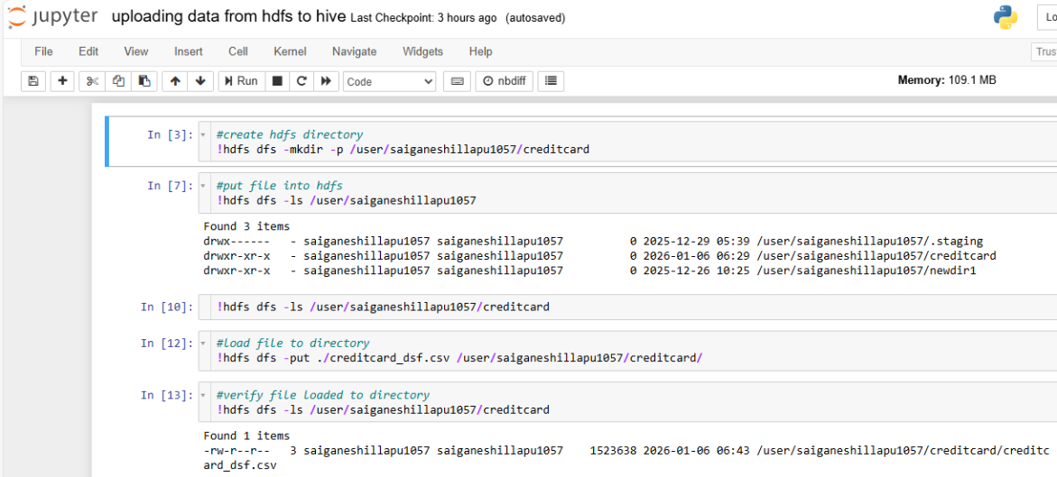
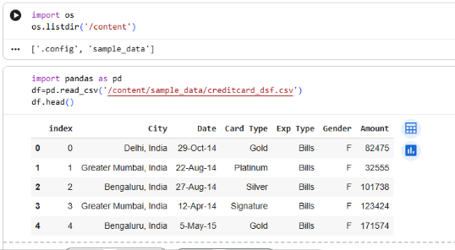
Scenarios using HiveQL
Create and Load Credit Card dataset into hdfs
Read file into Dataframe

Slide 21
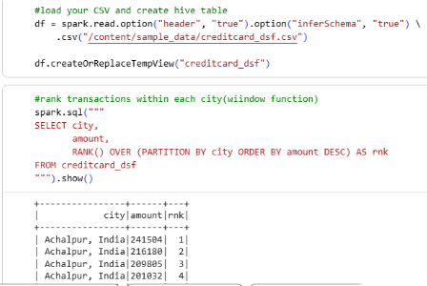
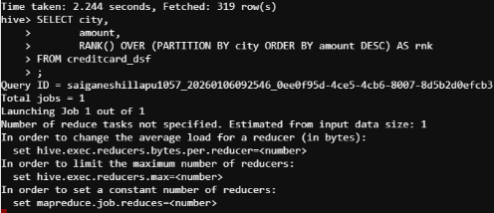
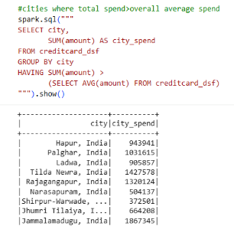
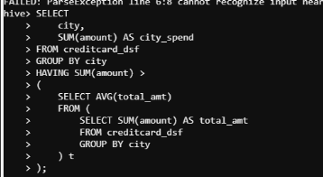
Rank transactions within each city by transaction amount
Cities where
total spend > overall average spend

Slide 22
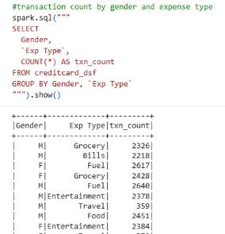
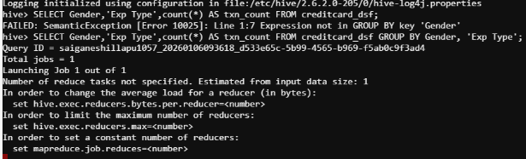
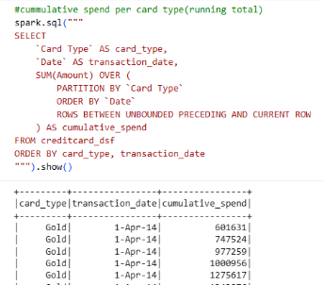
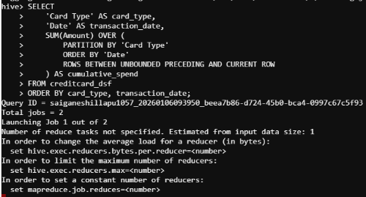
Transaction count by gender and expense type
Running total spend per card type

Slide 23
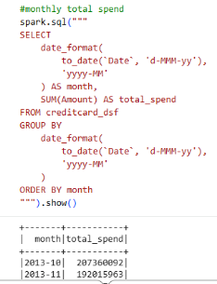
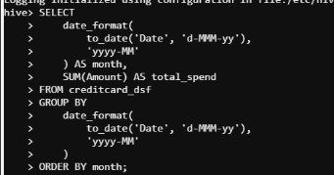
Monthly total spend

Slide 24
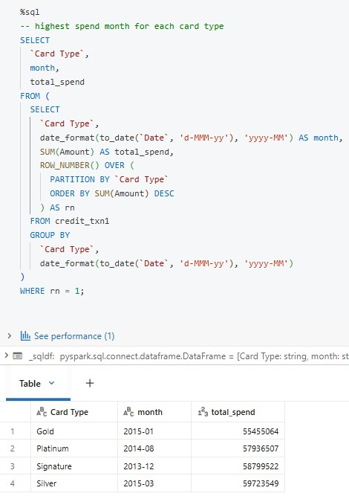
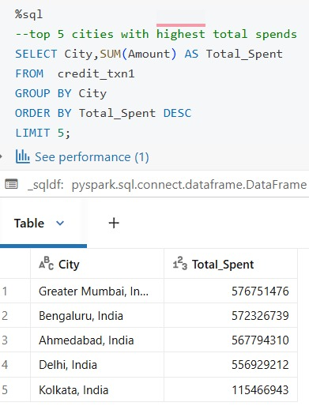
sparksql
Top 5 cities with Highest total spends​
Highest spend month for each card type​

Slide 25
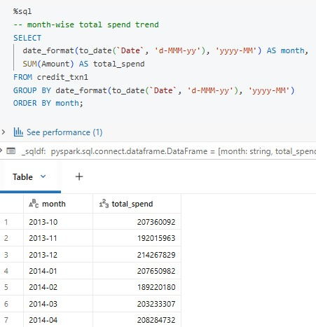
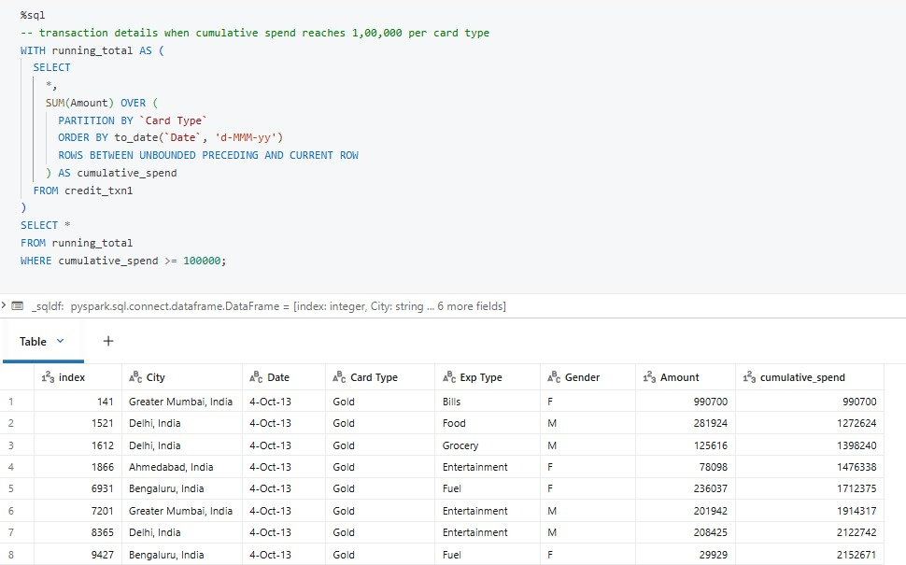
Month-wise total spend trend
Transaction details when cumulativespend reaches 1,00,000 per card type​

Slide 26
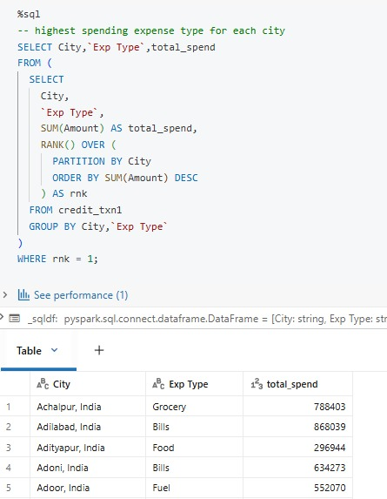
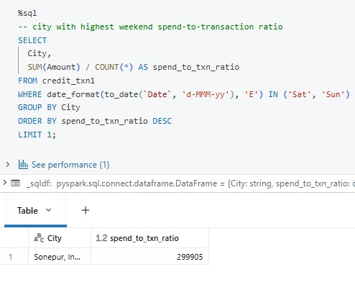
City with highest weekend spend-to-transaction ratio
Highest spending expensetype for each city

Slide 27
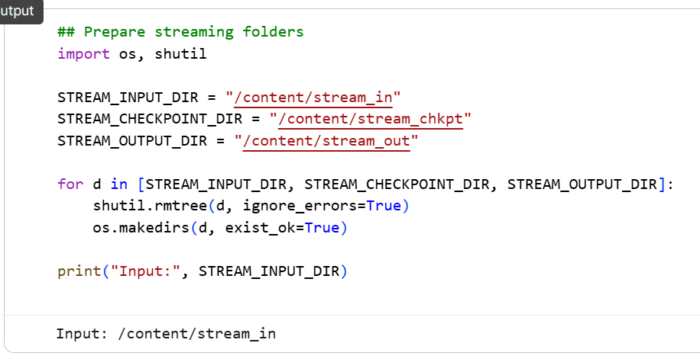
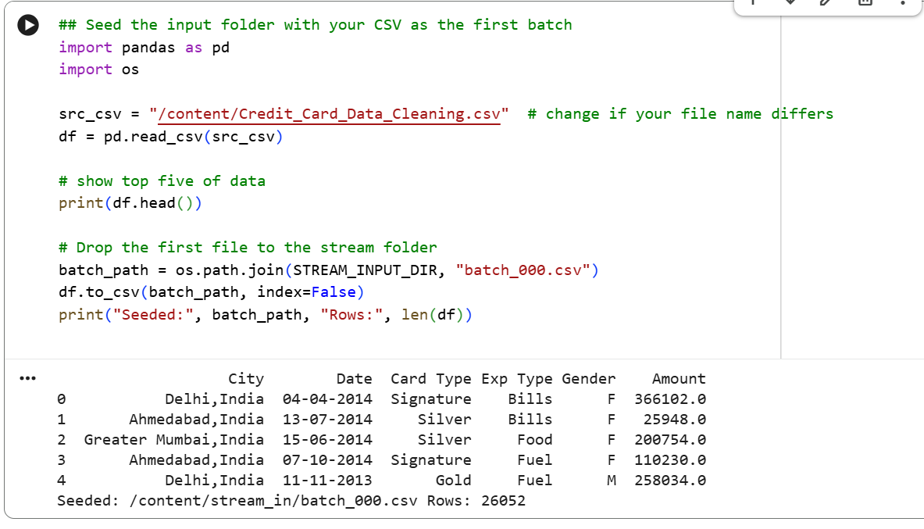
Spark Streaming
Prepare the streaming folders
Send the input folder with your csv as the first batch

Slide 28
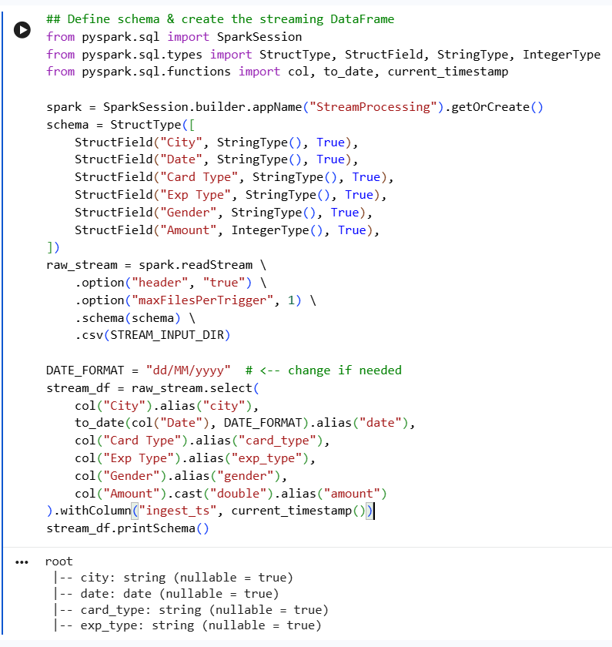
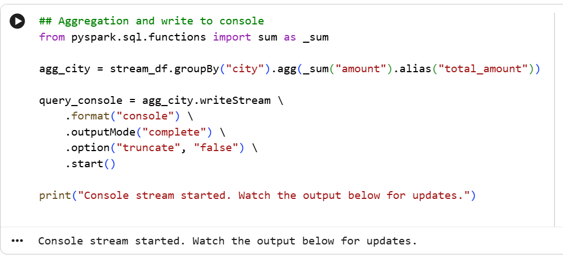
Define schema and create the streaming dataframe
Aggregate and write to console

Slide 29
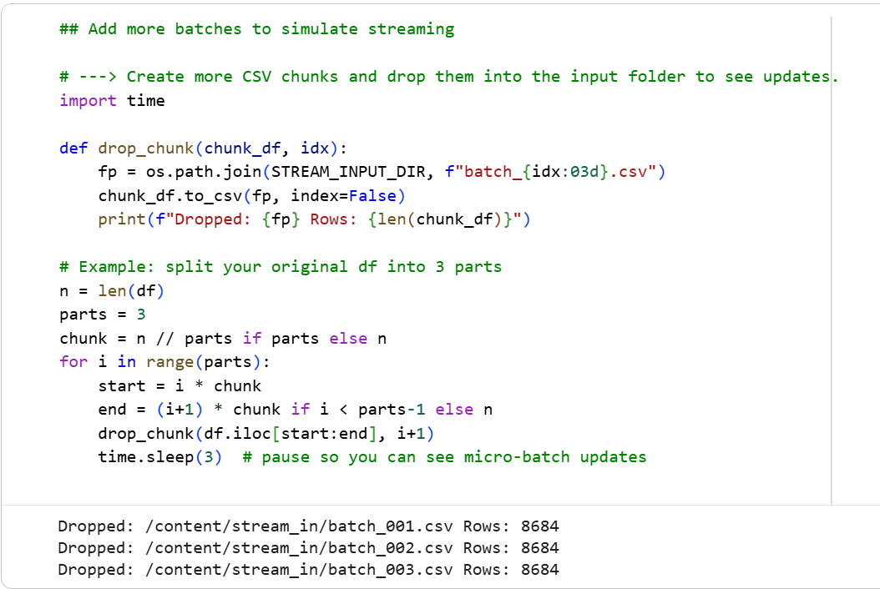
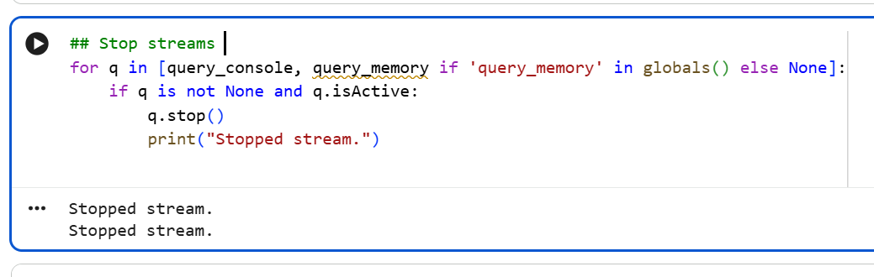
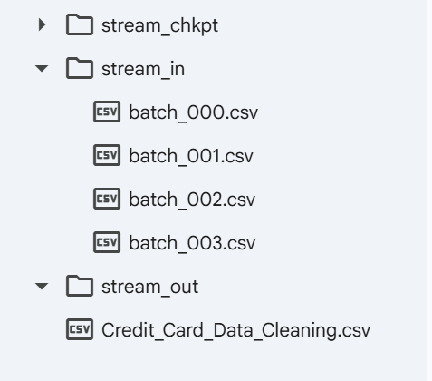
Add more batches to simulate streaming

Slide 30


Slide 31
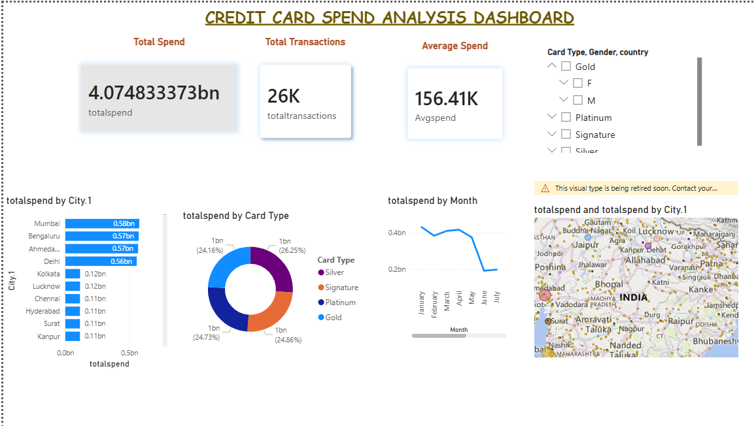
Overall Credit card spending insights and transaction analysis

Slide 32
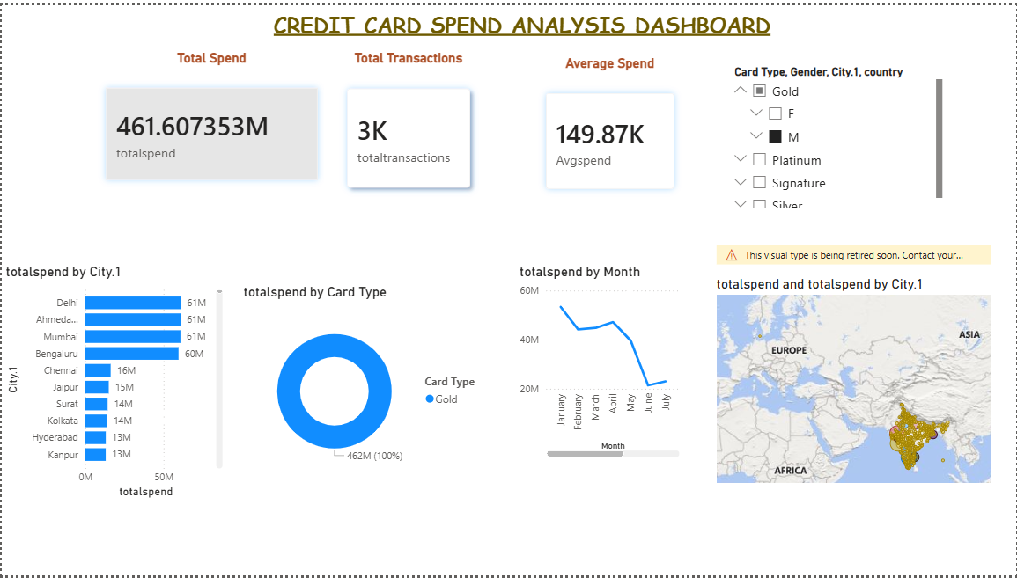
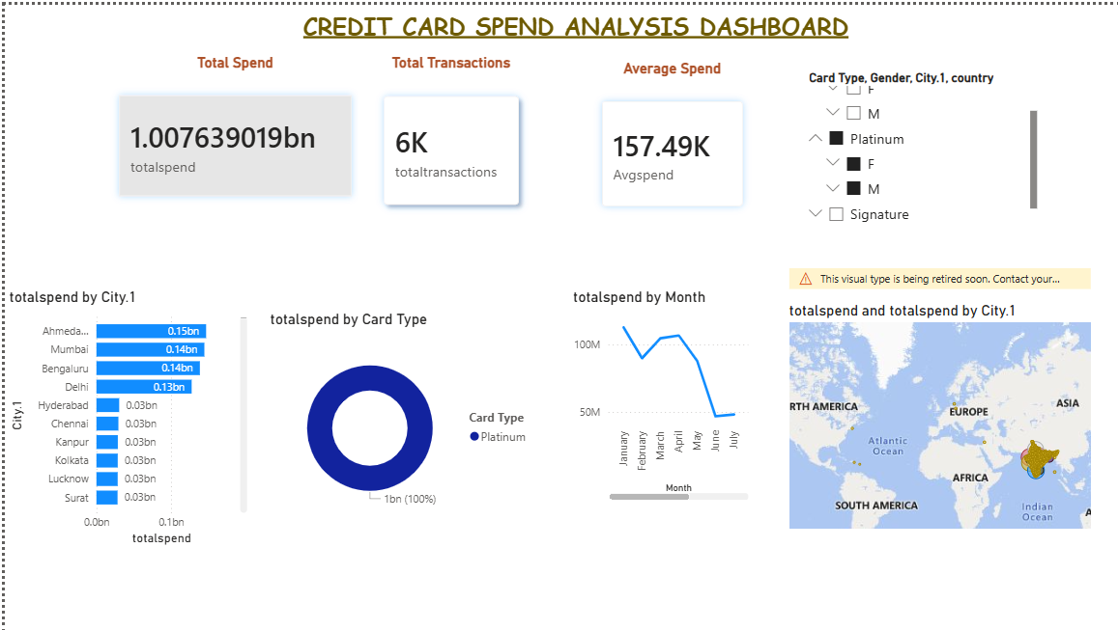
Platinum Report – Focuses on premiumcustomer spending and high valuetransactions
Gold Report – Analyzes mid -tier customerspending and city wise performance

Slide 33

Analyses premium Signature card spending patterns,highlighting high value transactions across cities andtime

Slide 34


Shows total spending comparison across all cities
Highlights the top 5 cities with the highest spend

Slide 35

Highlights the top 5 cities with the highest spend in geographical format

Slide 36


Slide 37


Slide 38


Slide 39

THANK YOU

Slide 40


